Slide 1
Snake Game(2d)
Name:Alam Al Saud
Id:011151346
Name: Mir Md. Akil
Id:011132068

Slide 2
Snake Game
It’s a snake game. Here we can play 2d traditional snake game.
Here first menu buttons will appear when game will start. Then the after pressing play button game will start.
If snake eat the egg then length will increase itself.
If snake cross the border then game will finish.

Slide 3
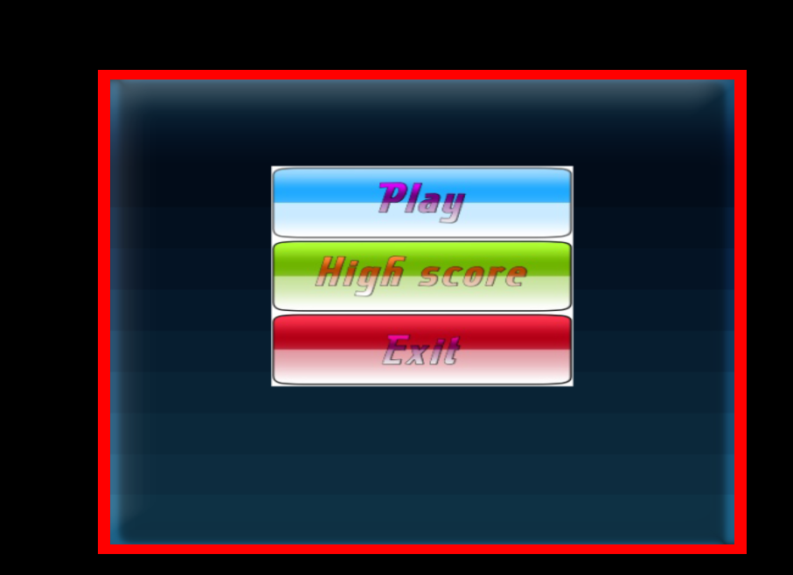
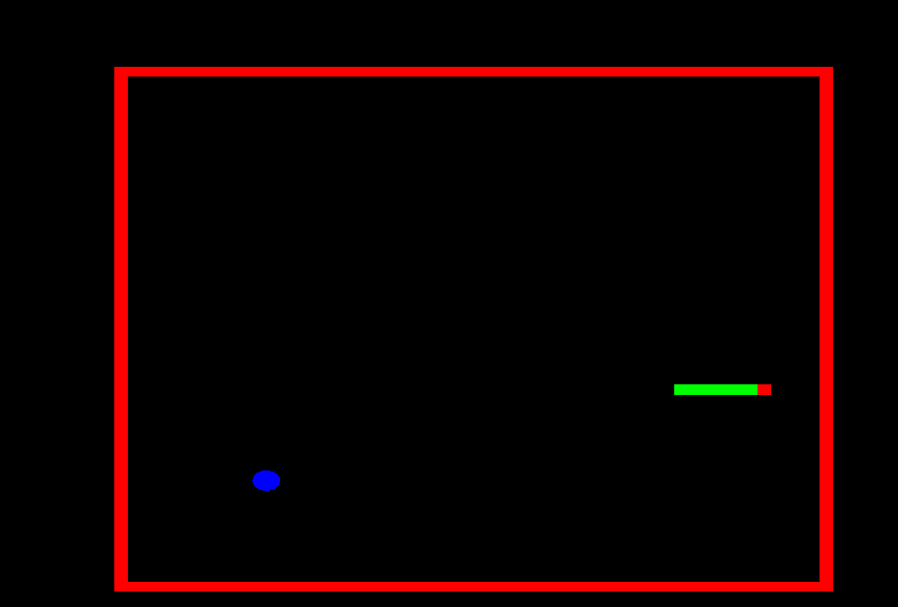
Screenshots

Slide 4
Individual task:
Alam Al Saud:
I have developed the logic of game . How snake will move toward and how the length of snake will increase .
Mir Md. Akil
I have added the snake body , egg and texturing.

Slide 5
Thank you

